Slide 1
Generalized Autocalibrating Partially Parallel Acquisitions (GRAPPA)
Lee Jaeeun
2018/02/06

Slide 2
Index
Introduction
Theory
GRAPPA
Overall process
Calibration & Reconstruction
‘Generalized’
Result
Conclusion
Discussion

Slide 3
Introduction
What is the GRAPPA?
New PPA method
Get the info from k-space (no need of accurate RF maps)
Extension of PILS & VD-AUTO-SMASH
The feature of GRAPPA
Steps of image reconstruction and combination are decoupled
Higher SNR and better quality of image than preceding PPA research

Slide 4
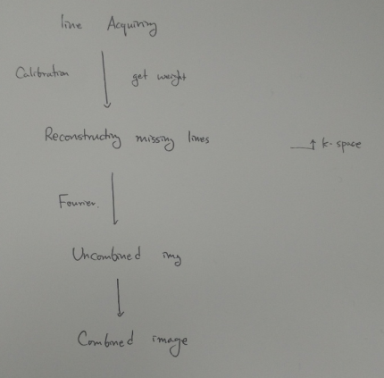
Theory
- Overall process

Slide 5
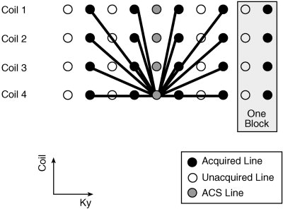
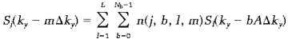
Theory
- Calibration & Reconstruction
1 2 3 4 5 6 7 8 9 10
j = 4
L=4
ky = 8
m = 3
del(ky) = 1
Nb = 4
A = 2
j : ACS line get weighted
L : total # of coils
Nb : # of blocks used in reconstruction
n(j,b,l,m) : weight
A : Acceleration factor

Slide 6
GRAPPA
Kx
Calibration
Ky
Ax = b

Slide 7
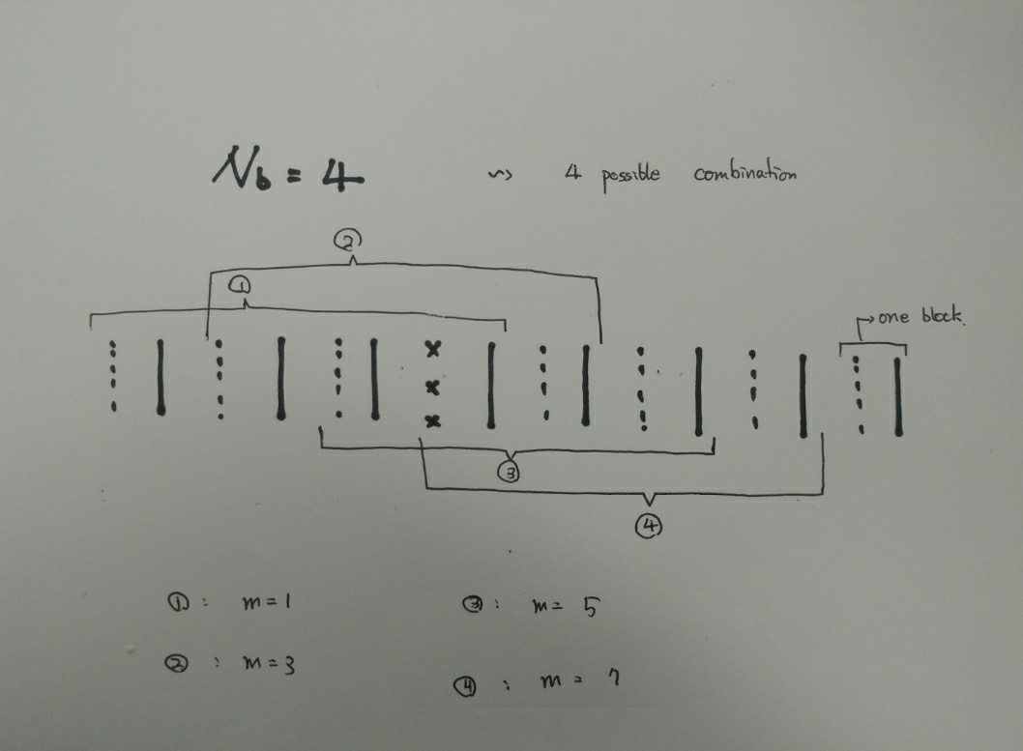
GRAPPA
Image reconstruction (sliding block approach)

Slide 8
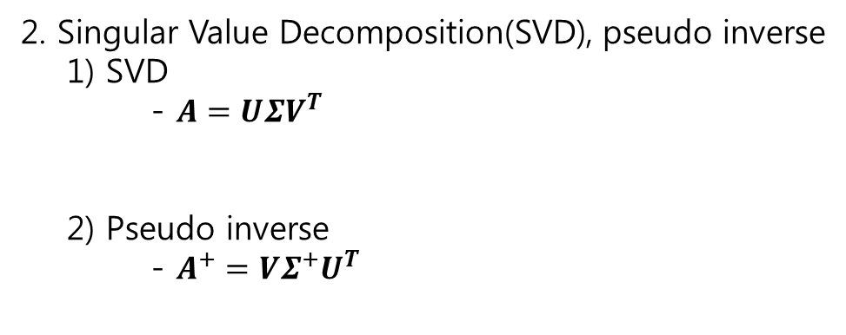
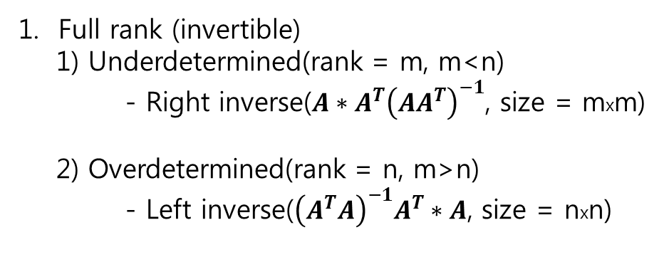
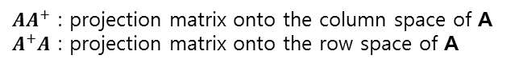
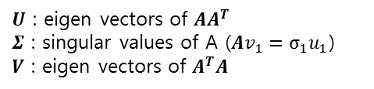
GRAPPA
Inverse
Ax = b
(mxn)
Full rank (invertible)
1) Underdetermined(rank = m, m<n)
- Right inverse($A∗A^{T}{\left(AA^{T}\right)}^{−1}$, size = mxm)
2) Overdetermined(rank = n, m>n)
- Left inverse(${\left(A^{T}A\right)}^{−1}A^{T}∗A$, size = nxn)
2. Singular Value Decomposition(SVD), pseudo inverse
1) SVD
- $A=UΣV^{T}$
2) Pseudo inverse
- $A^{+}=VΣ^{+}U^{T}$
$U$ : eigen vectors of $AA^{T}$
$Σ$ : singular values of A ($Av_{1}={σ_{1}u}_{1}$)
$V$ : eigen vectors of $A^{T}A$
$AA^{+}$ : projection matrix onto the column space of A $A^{+}A$ : projection matrix onto the row space of A

Slide 9
GRAPPA
Reconstruction
Ax = b

Slide 10
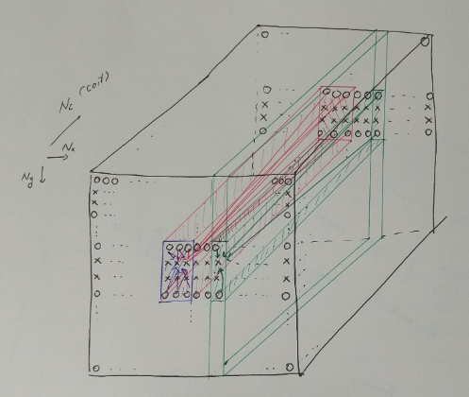
GRAPPA
Generalized
W1 W2 W3

Slide 11
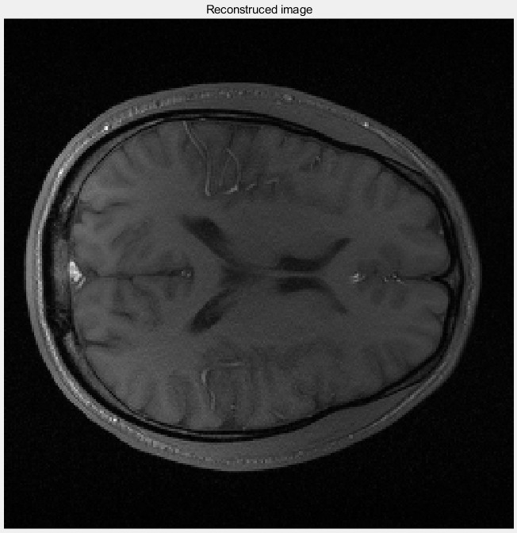
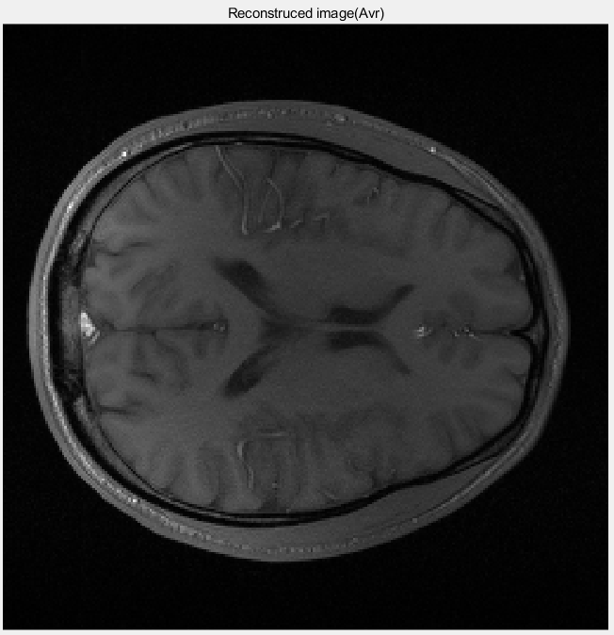
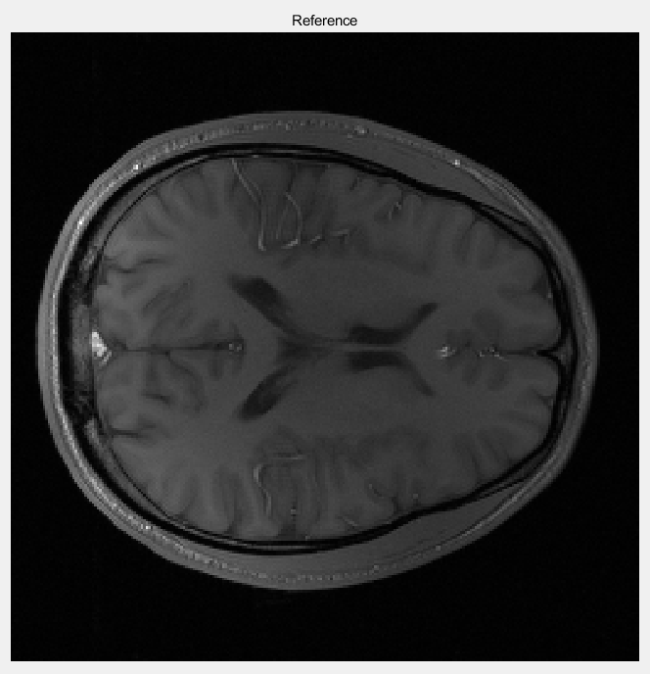
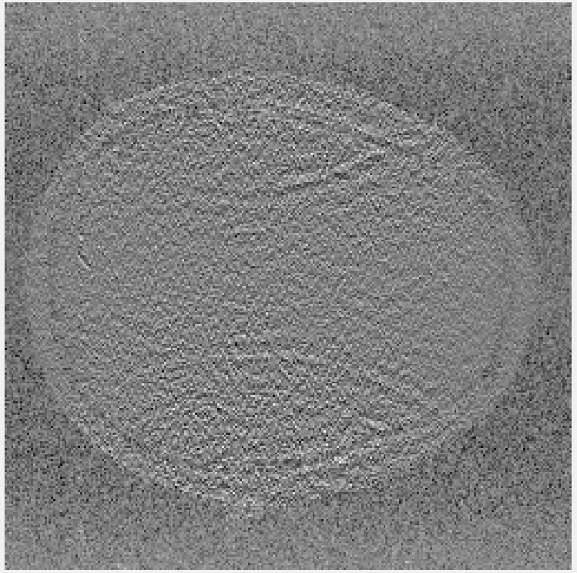
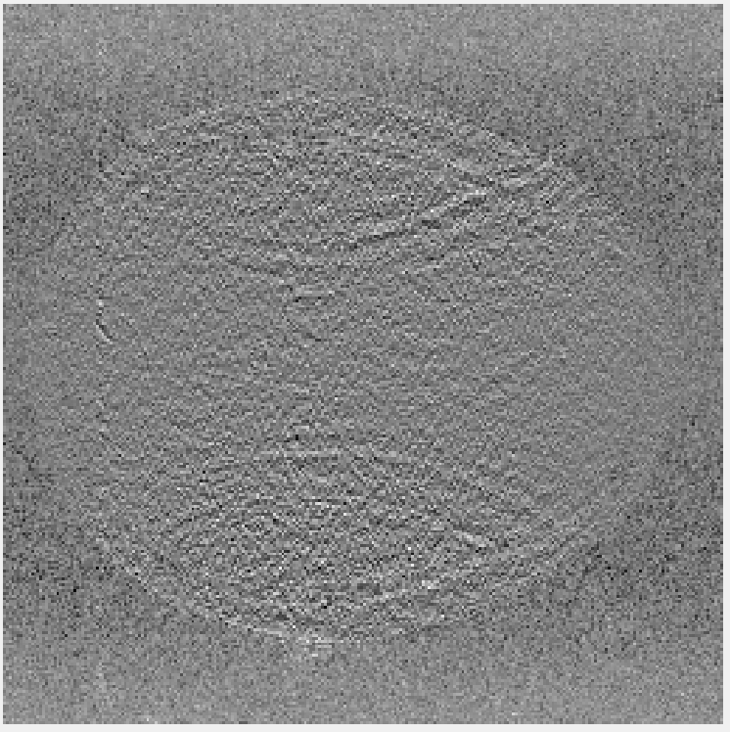
GRAPPA
Generalized
(Nb = 4, Acc_factor = 2, Acs = 20)

Slide 12
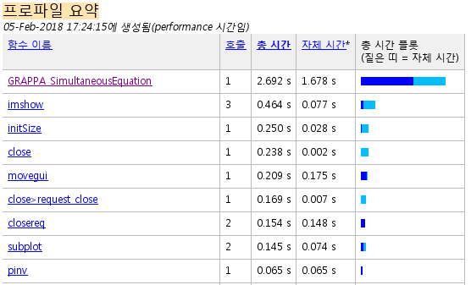
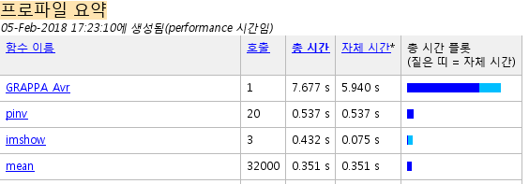
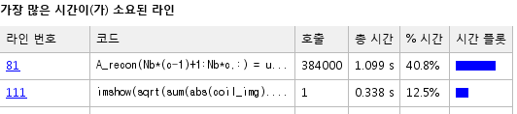
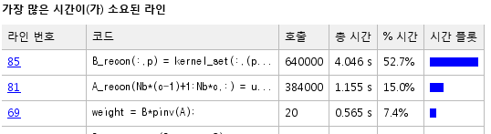
GRAPPA
Generalized
(Nb = 4, Acc_factor = 2, Acs = 20)

Slide 13
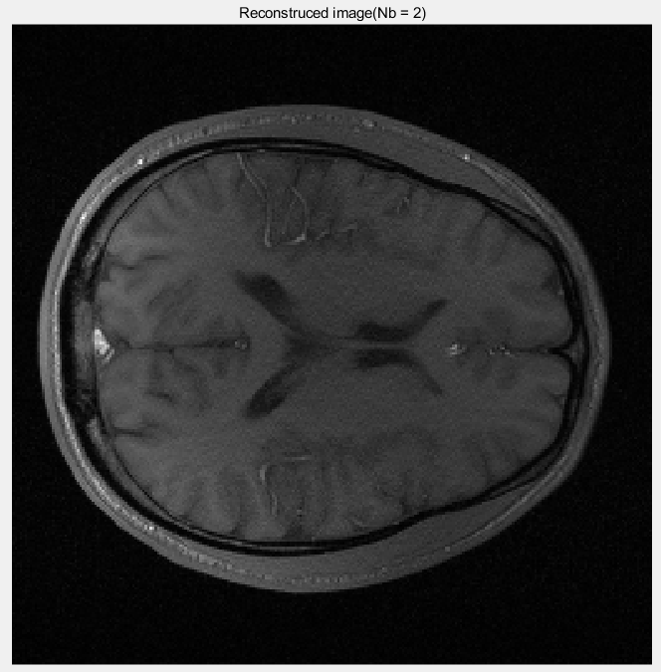
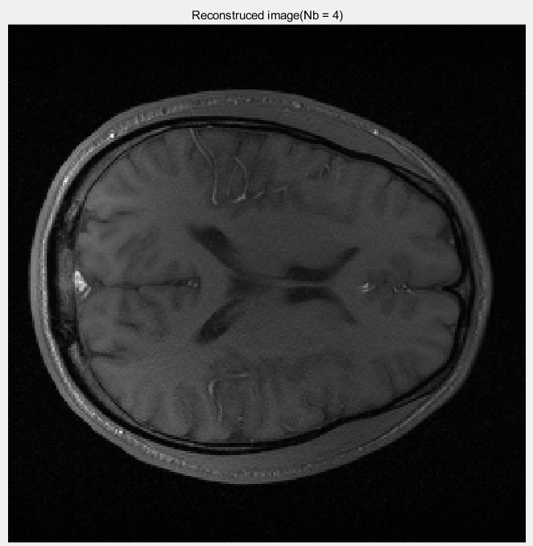
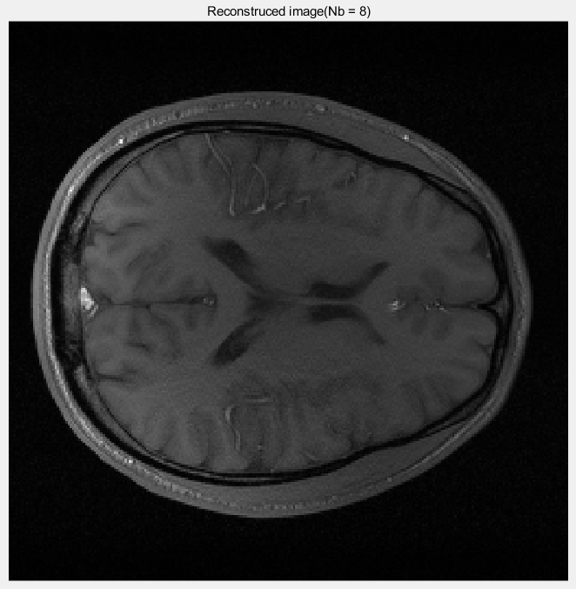
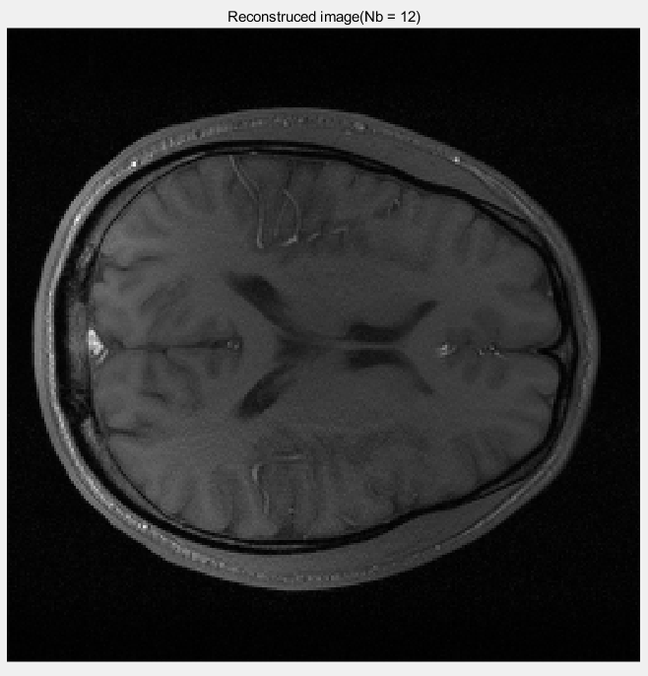
Result
1) Nb (Acc_factor = 2, Acs = 20)

Slide 14
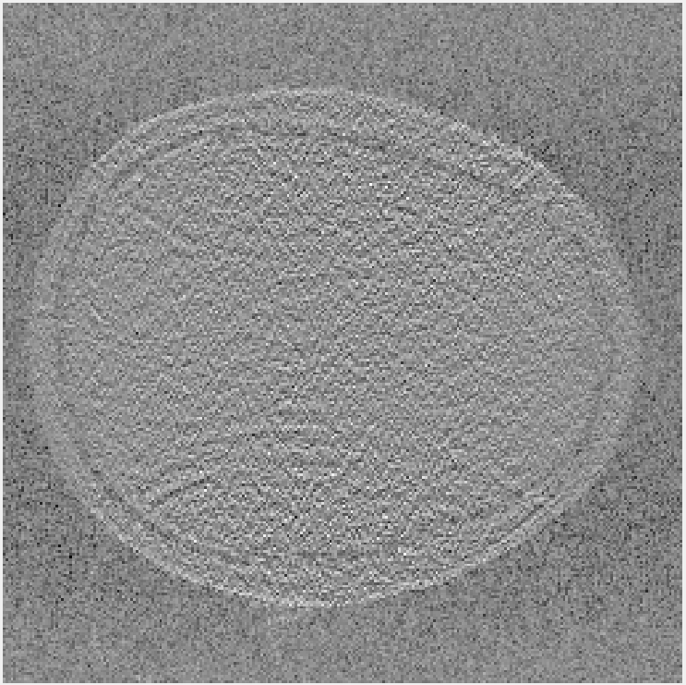
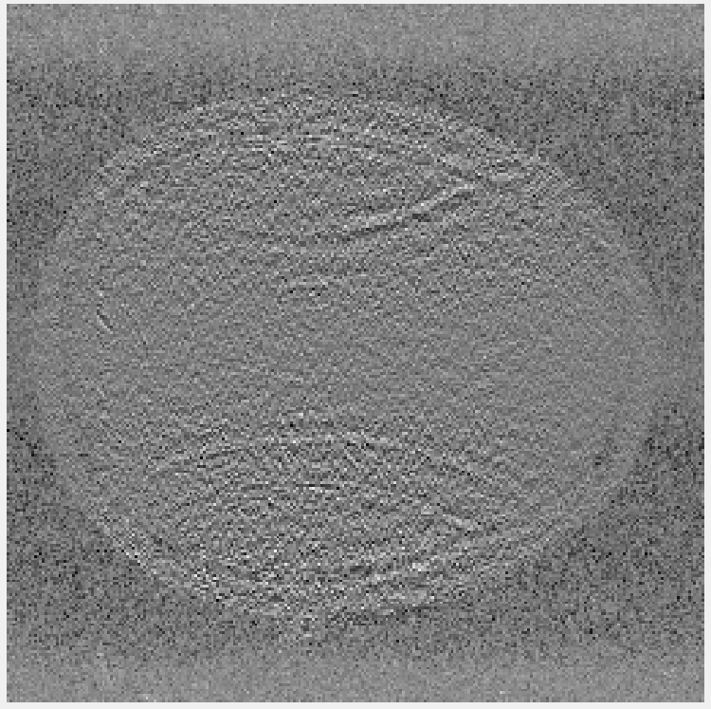
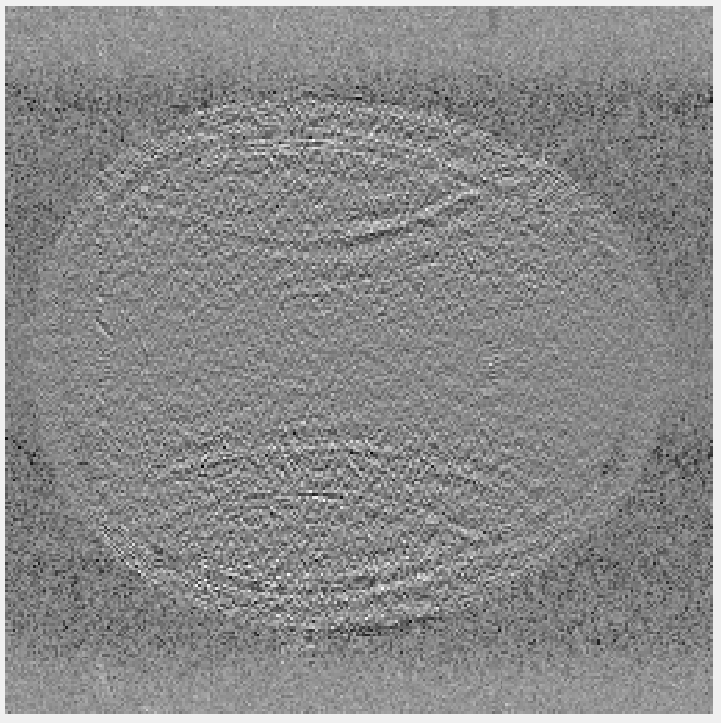
Result
1) Nb (Acc_factor = 2, Acs = 20)

Slide 15
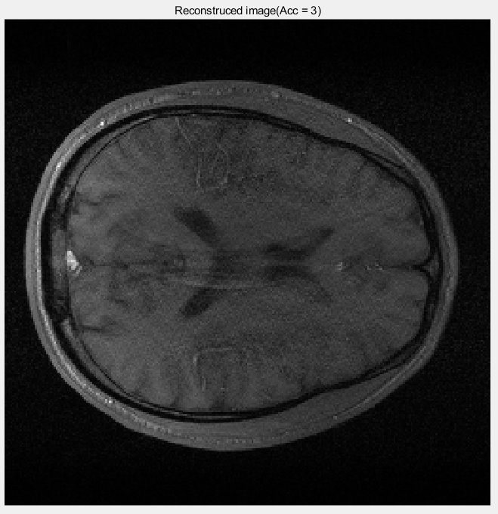
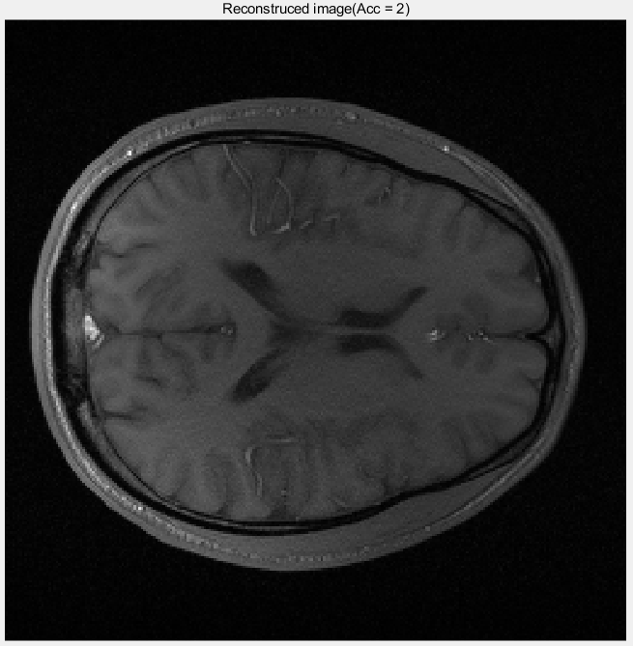

Result
2) Acceleration factor
(Nb = 4, Acs = 20)

Slide 16
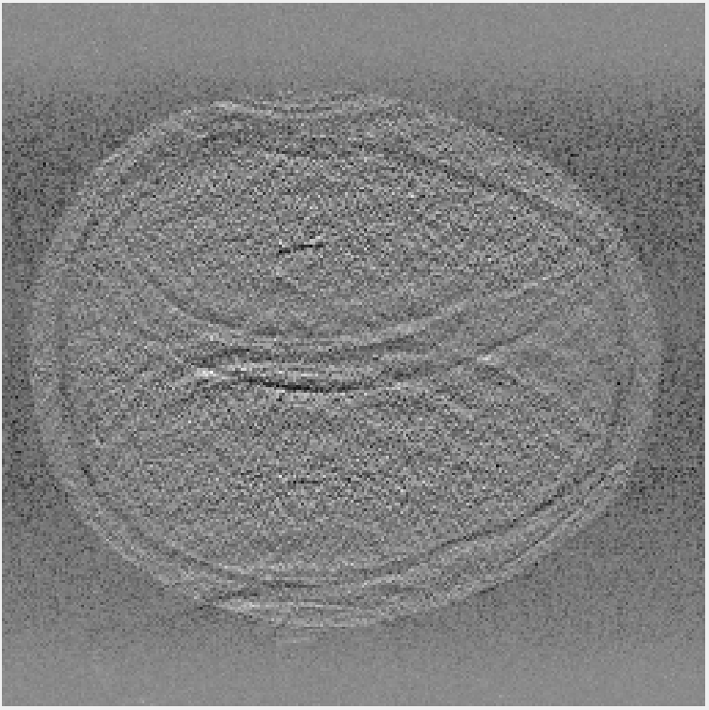
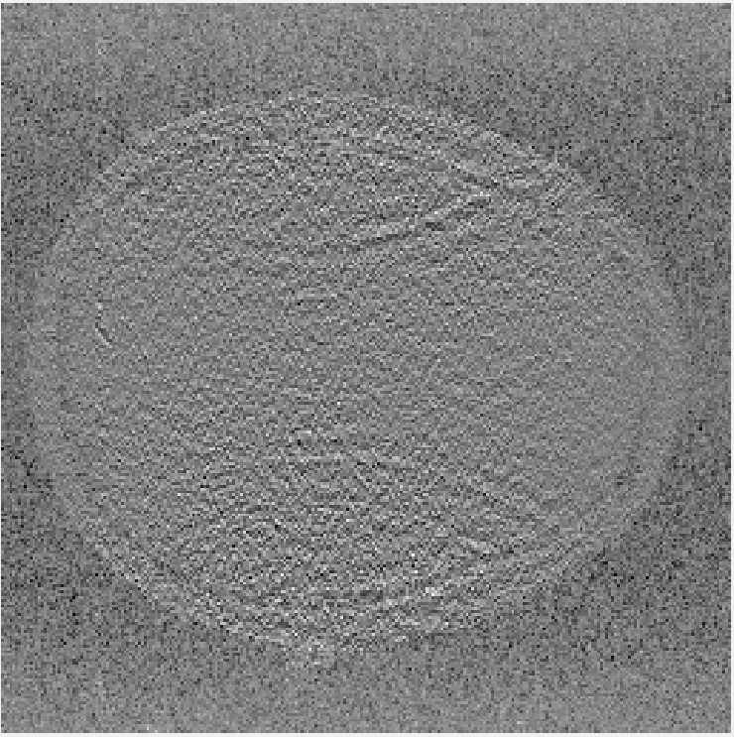
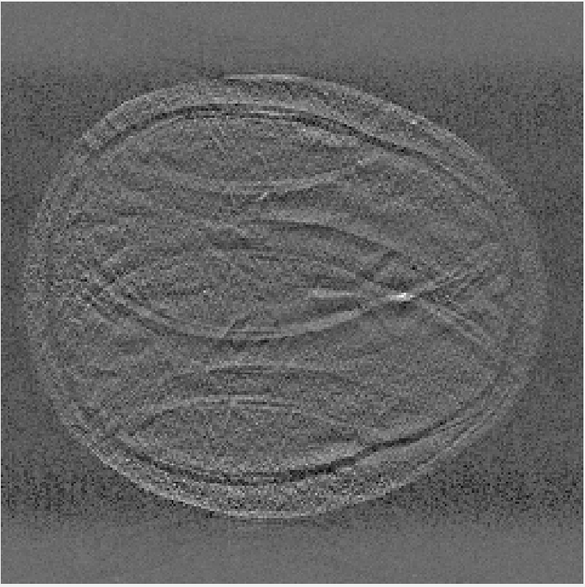
Result
2) Acceleration factor (Nb = 4, Acs = 20)

Slide 17
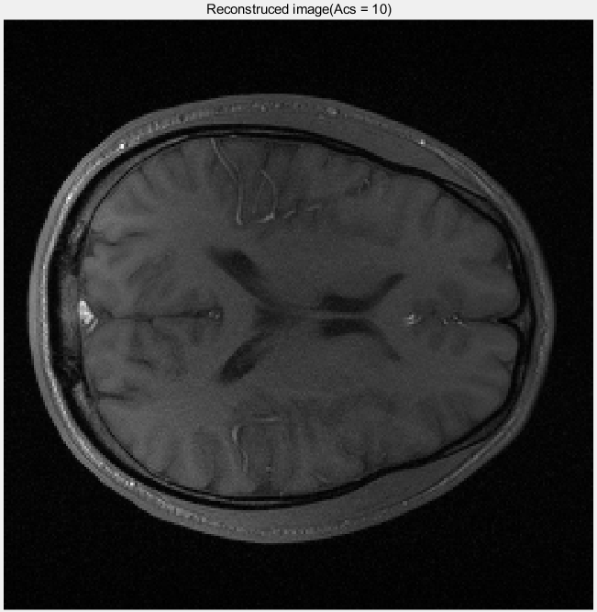
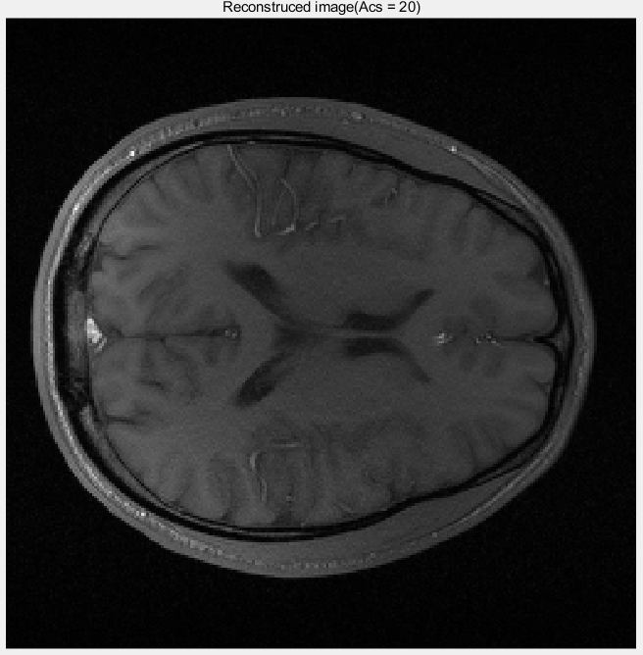
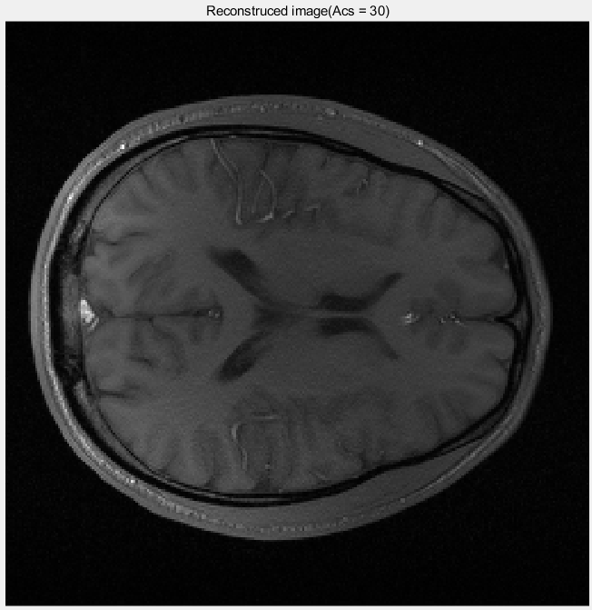
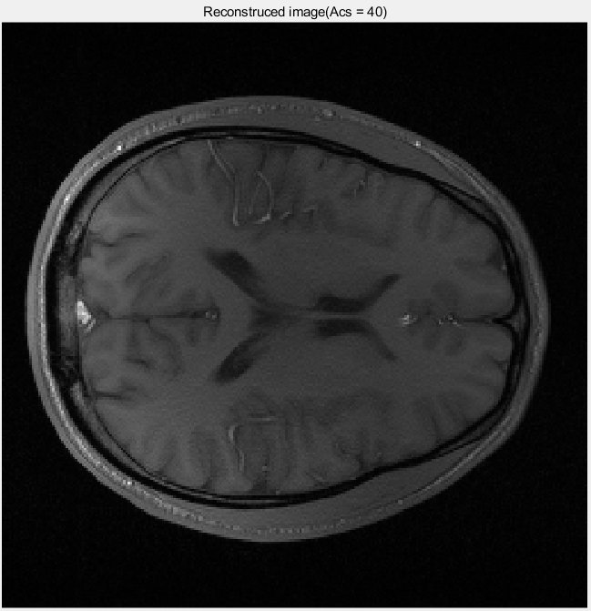
Result
53.91%
57.81%
3) Number of ACS lines
(Acc = 2, Nb = 4)
61.72%
65.63%

Slide 18
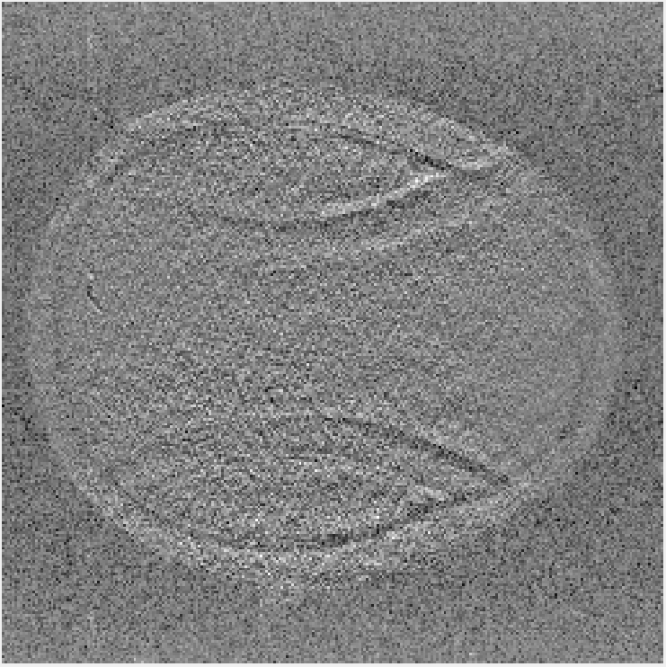
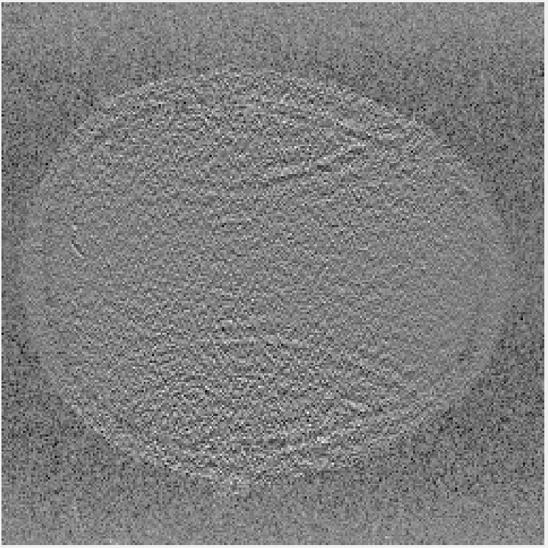
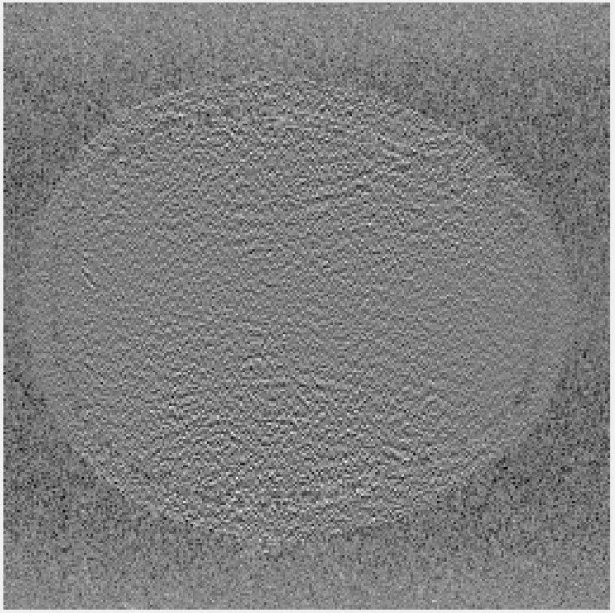
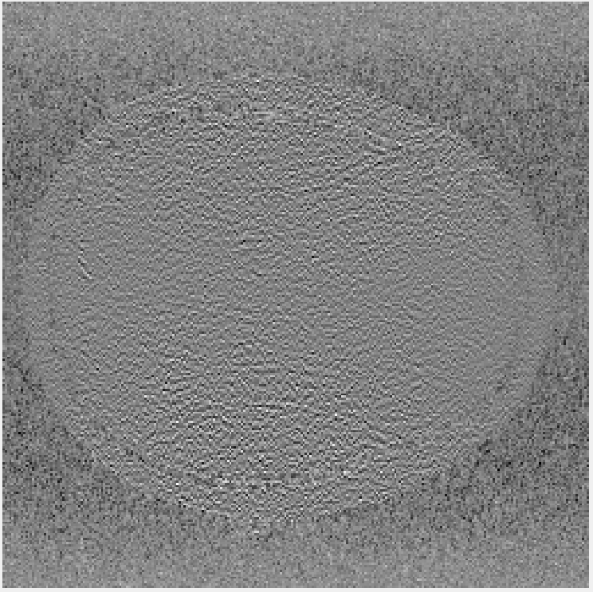
Result
53.91%
57.81%
3) Number of ACS lines
(Acc = 2, Nb = 4)
61.72%
65.63%

Slide 19
Conclusion
An extended blockwise VD-AUTO-SMAHS reconstruction
Particularly useable in areas where coil sensitivity maps are hard to obtain
Effect of variables : Acceleration factor > Number of ACS lines > Number of blocks

Slide 20
Discussion
Using adaptive array combination instead of sum of square
If we got the highly accurate coil sensitivity map, SENSE is better
A variety number of way to get the ACS lines.
How to judge that one image is better than other? (SNR, normalise)

